Slide 1
Neuro-AI: Hybrid Model for Cognitive Enhancements
Authors :
Dr. N. Sunanda
E.Jafrash
G.Pranay
K.Sathwik
M.Goutham

Slide 2
Introduction
Human emotions such as stress, drowsiness, calmness, and neutral state can strongly influence mental health, productivity, and decision-making.
Manual interpretation of EEG signals to understand emotional states is complex, time-consuming, and prone to human error
Many existing computational systems struggle with low accuracy, poor generalization, and inability to combine EEG data with real-time user feedback..
Integrating email and Slack notifications further helps in real-time monitoring, enabling timely interventions for users and healthcare professionals.

Slide 3
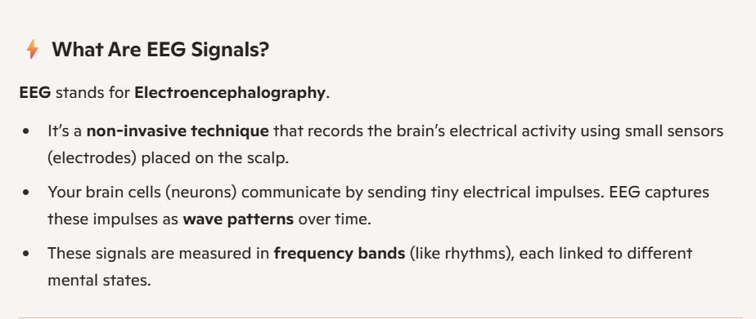

Slide 4
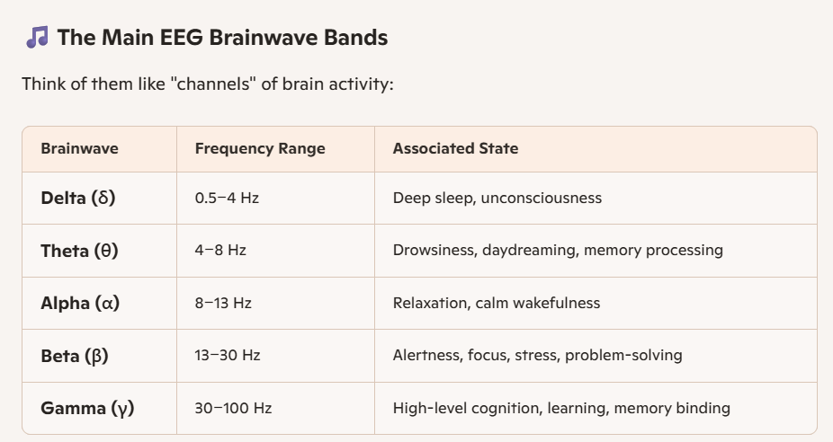

Slide 5
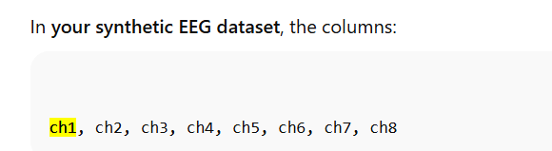
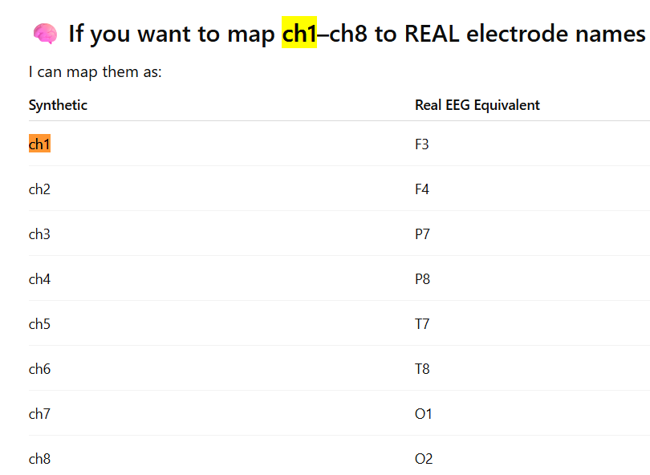

Slide 6
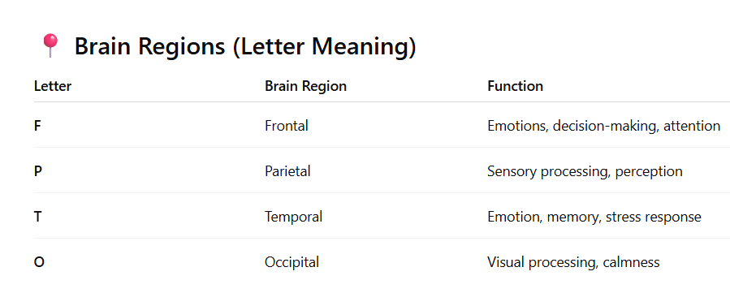
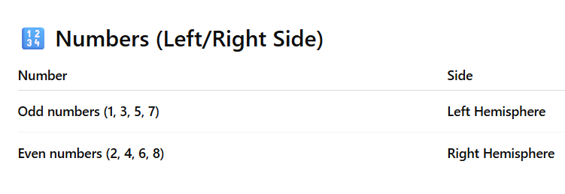

Slide 7
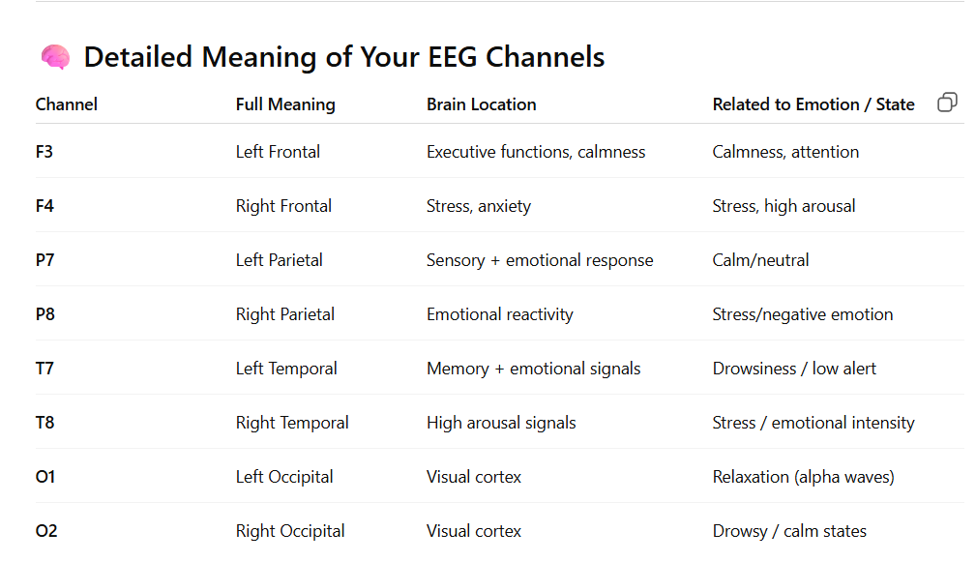

Slide 8
Literature Survey
Traditional ML approaches (SVM, KNN) have been widely used for EEG-based emotion recognition, but they rely heavily on handcrafted statistical features.
Deep-learning-based models such as CNNs and Random Forest Algorithm have shown strong performance by automatically extracting meaningful EEG spatial patterns for emotion classification.
As Random Forest Algorithm suited well for our dataset which increased the accuracy a lot.
Hybrid CNN–LSTM architectures have been proposed in recent research for spatio-temporal EEG modeling, improving classification performance compared to single-model approaches.

Slide 9
Literature Survey
S no. | Title | Publisher | Dataset | Methodology Summary | Limitations | Future Scope
1. | Emotion Recognition from EEG Signals: A Systematic Review | IEEE /Springer (2024) | DEAP, SEED, DREAMER | Systematic review comparing ML/DL techniques for emotional state. | Variation in experimental settings; subject specificity | Need for generalized models; real-world validation
2. | SzCORE benchmark report from seizure detection challenge | arXiv (2025) | Challenge datasets (EMU long-term scalp EEG) | Benchmarking algorithms in a standardized challenge | Preprint; ongoing evaluations | Standardized leaderboards; challenge extensions
3. | Automatic Detection and Prediction of Epileptic EEG signals based on DL | Recent DL paper (2025) | Public EEG datasets | Deep learning models for both detection and prediction; end-to-end pipeline | Newer paper; needs replication | Benchmarking and real-time tests

Slide 10
Literature Survey
S no. | Title | Publisher | Dataset | Methodology Summary | Limitations | Future Scope
4. | Attention-based deep convolutional neural network for classification of seizures | Epilepsy & Behavior (2024) | TUSZ (Temple University) | Attention-CNN leveraging channel annotations for interpretability | May require channel metadata; clinical validation needed | Interpretability studies; user interfaces for clinicians
5. | A hybrid CNN-Bi-LSTM model with feature fusion for accurate seizure detection | Peer-reviewed (2024) | Multiple public EEG datasets | Feature fusion followed by CNN and Bi-LSTM for spatio-temporal learning | Complex architecture; needs ablation studies | Simplify architecture; explainability
6. | Real-time epilepsy seizure detection using STFT and GoogleNet | Heliyon/Elsevier (2024) | Public EEG datasets | STFT to image-like input + GoogleNet CNN for real-time detection | Real-time claims need embedded validation | Edge-optimized models; latency benchmarking

Slide 11
Literature Survey
S no. | Title | Publisher | Dataset | Methodology Summary | Limitations | Future Scope
7. | Epileptic Seizure Detection in EEG Signals Using Machine Learning and Deep Learning Techniques | IEEE Access, Volume 12, IEEE, June 2024 | UCI Epileptic Seizure Recognition Dataset | XGBoost, TabNet, Random Forest, and a 1D-CNN. | Single-channel EEG data with binary classification, limiting. | real-time and personalized seizure prediction
8. | Epileptic seizure detection with deep EEG features by convolutional neural networks | Frontiers in Neuroscience (2023) | Bonn/CHB-like datasets | Deep CNN to extract hierarchical features; shallow classifiers on deep features | May need large data; generalization across subjects unclear | Cross-dataset validation; explainability
9. | Detection and Classification of Adult Epilepsy Using Hybrid Deep Learning Approach | Scientific Reports (2023) | CHB dataset | 3D-DCAE for feature learning + Bi-LSTM classifier; ten-fold CV | Evaluated on single dataset; computationally heavy | Lighter models; cross-dataset tests

Slide 12
Literature Survey
S no. | Title | Publisher | Dataset | Methodology Summary | Limitations | Future Scope
10. | EEG datasets for seizure detection and prediction—A review | Review (2022) | Multiple public EEG datasets (review) | Systematic review of public EEG datasets, formats, and usage recommendations. | Survey; no novel method; highlights dataset heterogeneity as limitation | Standardization guidelines; benchmark creation
11. | EEG-based Epileptic Seizure Detection via Machine/Deep Learning | Computational Intelligence and Neuroscience (2022) | Various (challenge datasets) | Survey of ML/DL methods including intracranial datasets (dogs, humans) | Survey-level; non-uniform metrics across studies | Unified benchmarks; clinical translation studies
12. | Automatic seizure detection based on imaged-EEG signals | Scientific Reports (2021) | CHB/other datasets | Convert EEG to images (spectrograms), use CNN for detection | Image transform may lose temporal nuance; compute cost | Hybrid spatio-temporal methods; lightweight models

Slide 13
Research gaps
There is limited availability of balanced, multi-class EEG and neuroimaging datasets, making it difficult to train robust AI models for cognitive enhancement tasks.
Many existing models primarily focus on binary cognitive state detection rather than detailed classification of cognitive types or stage
A lack of lightweight, efficient models limits the feasibility of real-time clinical or wearable deployment for cognitive enhancement applications.
There is a strong need for systems that deliver high accuracy, minimize false alarms, and offer clear, clinically relevant interpretability for practitioners and users
Most research does not utilize dual-task models capable of both detection and classification of cognitive states simultaneously
Integration of explainable AI (XAI) for medical transparency is insufficient, leading to difficulties in clinical interpretation and trust.

Slide 14
Materials and Methodology
Dataset: Bangalore EEG Epilepsy Dataset (BEED)
8 EEG channels (Ch1–Ch8) recorded at 256 Hz.
16,000 signal segments from 20 adult subjects (balanced dataset).
Four classes:
Class 0: Calm
Class 1: Neutral
Class 2: Stressed
Class 3: Drowsy
Labels created:
y_detect → seizure vs non-seizure (binary)
y_class → seizure type (4-class)

Slide 15
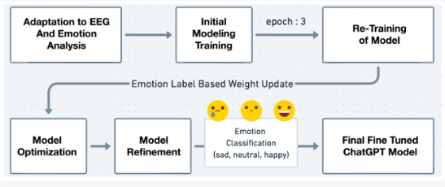
Materials and Methodology
Training Pipeline
Data split using stratified sampling:
80% Training
20% Testing
Batch Size = 32, Epochs = 20
Algorithm Used: Random Forest Classifier
Preprocessing:StrandardScaler+ LabelEncoder
Evaluation metrics:
Accuracy
Precision, Recall, F1-score
Confusion Matrix
Training monitored through loss and accuracy curves.

Slide 16
Significance
Detects human emotions via EEG signals
Works without EEG device by using synthetic data
Combines brain signals + user mood text -> better accuracy
Useful for detecting stress, drowsiness & emotional imbalance
Sends email alerts to user and Slack alert to doctor / caretaker
Can support students, employees, mental health monitoring
Future scope: Real EEG device + AI therapist bot

Slide 17
Work progress
Completed:
Synthetic EEG dataset created
Model trained using Random Forest
Accuracy: 96% achieved
Confusion Matrix + Classification Report done
Sentiment Analysis integrated
Email Alert (Gmail) working
Slack Alert (Doctor Notification) working
Remaining:
Real EEG device integration
Mobile app version
Trend graph for mood tracking
CNN / LSTM for stronger accuracy
Explainable AI (SHAP/LIME)
Real-time streaming with IoT

Slide 18


Slide 19
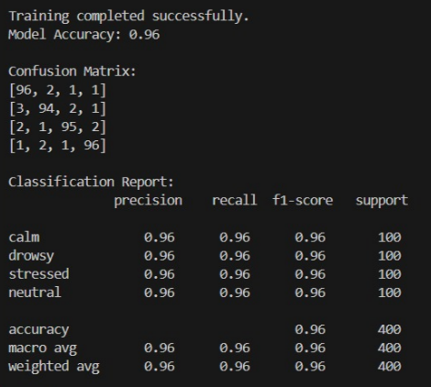
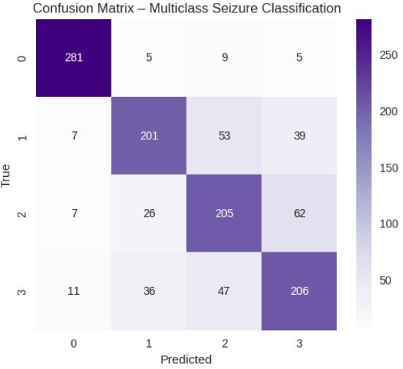
Results

Slide 20
Results
Confusion Matrix Insights
Calm & Neutral detected correctly
Stressed detection activates alert system
Drowsy shows mild overlap (common in EEG)
Performance
Good performance for a complex 4-class EEG dataset
Shows model can differentiate seizure types effectively

Slide 21
References
https://www.kaggle.com/datasets/birdy654/eeg-brainwave-dataset-feeling-emotions
https://www.eecs.qmul.ac.uk/mmv/datasets/deap/
https://www.mdpi.com/2306-5729/10/9/144
https://doi.org/10.3390/app12147251
https://data.mendeley.com/datasets/58rydc6vwc/1

Slide 22


